Slide 1
DAA Assignment – Text Counting and Prediction Using NLP
1
By:
Tarun Tanmay N049
Jai Verma N060

Slide 2
A Brief Introduction to NLP
NLP or Natural Language Processing is a sub-field of computer science that involves the automated use of natural language by software. This isn’t a new field like most would expect it to be and has actually have been around for over 50 years.
NLP was created as a hybrid of linguistics and computer science and was created out of a necessity for computers which would understand the ways in which humans communicated.
When you type text into a computer, it is able to process it but it cannot understand what you have written. However, that is what NLP is here to accomplish.
In fact, the Turing Test (a test to check whether an AI is truly intelligent) itself is based on the ability of a machine to communicate in natural language.
2

Slide 3
Major Examples of NLP in Everyday Life
Since NLP is not new, it has been used in several aspects of everyday life. Here are some such examples of NLP being used in our daily lives:
Autocomplete and Autocorrect typing features utilize NLP to predict the word you are typing. Predictive Typing, which has recently been introduced in software such as Gmail allows the machine to predict your entire reply to a conversation.
All smart assistants such as the Google Assistant and Amazon Alexa utilize speech patterns to understand the context of what is being said.
While translating using apps such as Google Translate is still far from perfect, it has gotten a lot better at translating with correct grammar and context.
3

Slide 4
Why is NLP Good for Searches?
NLP is an excellent tool to apply to your search algorithms. With its help, search engines such as Google are able to find results that don’t only match the keywords, but also other contextual factors.
A good example of this is the Hummingbird Algorithm which was introduced by Google in its searches in 2013. It utilized natural language processing among 200 other factors to rank search results based on the context of each search.
NLP can also help speed up searches by making it possible to get results quite fast as seen with our project.
4

Slide 5
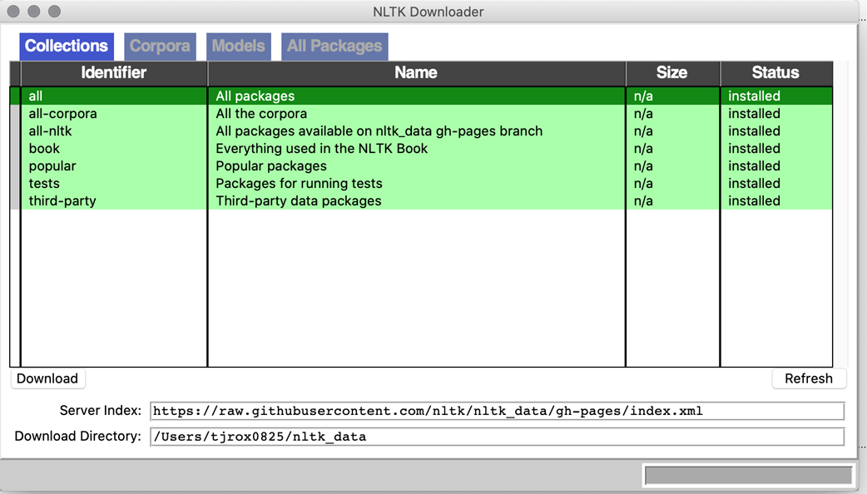
NLTK – Natural Language Toolkit for Python
5
NLTK or Natural Language Toolkit is an extremely popular platform for coding python programs to work with datasets of natural human language.
It comes with an easy-to-understand guide, which makes it quite suitable for use by beginners in the world of NLP. Moreover, it is open source which allows its use in commercial projects as well as educational ones such as the one we are making.

Slide 6
What is the Need for NLTK
NLTK comes with several inbuilt tools and functions which make it quite easy to implement NLP in a python program.
It also includes over 50 corpora and language resources and text processing libraries.
This can allow beginners in NLP to get a hands-on experience with the technology and start learning more about it. It has therefore allowed us to make this project despite never officially learning NLP before.
6

Slide 7
CORPUS
A corpus is a collection of various text documents which could be original texts or transcribed speeches. This is used as a linguistic tool which allows linguists to verify their thesis about language.
This is used in NLP for various purposes and can refer to a large structured dataset of machine-readable tests which can allow it to learn more about natural communication. It can be used for training of advanced NLP algorithms such as Neural Networks.
In our project, we have utilized the corpus called Inaugural which contains transcriptions of the speeches of all the US presidents from 1789 to 2009. The total word count exceeds 3 million words.
7

Slide 8
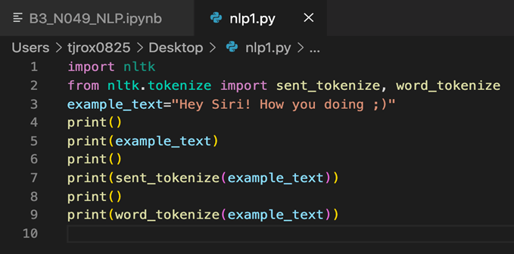
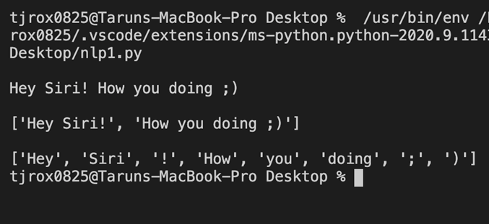
Tokenization
8
Tokenization is the process which includes the process of segmenting a string of text into individual sentences and words. These segments are then called tokens which are created after removing various unneeded features of the text such as punctuation. This can work in other languages than English as well, however it gets more complicated with languages that don’t use spaces after each word.

Slide 9
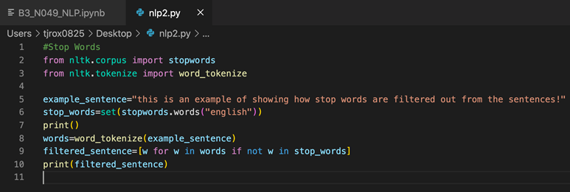
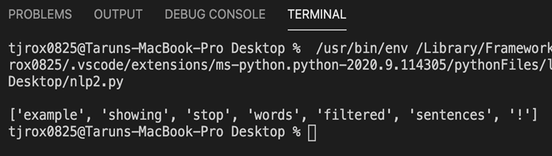
Stop Words
9
This is another pre-processing step in the process to clean up the data for processing by the NLP model. Stop words are special filters that need to be removed from the analysis. These are essentially words without any real meaning to the information that you need from the text and can sometimes create conflict with the data.
Essentially it can get rid of words such as prepositions, articles, and pronouns. This filtered data can then be processed a lot easier since it does not have all those words.

Slide 10
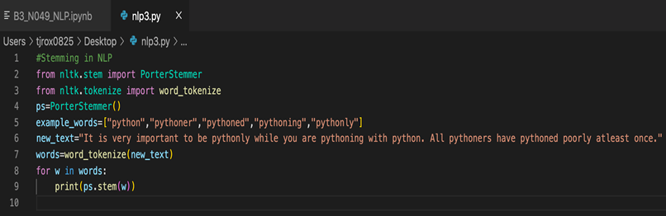
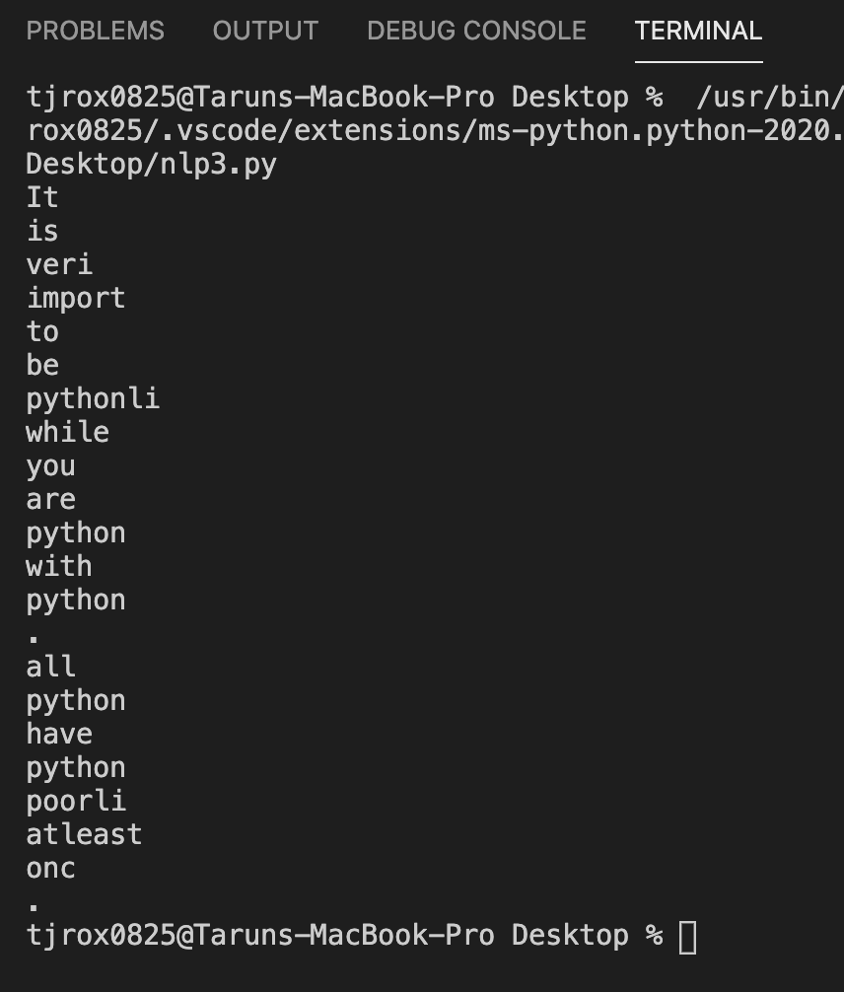
Stemming
10
Stemming is a process in NLP which can slice strings at their ends or beginnings to ensure that they get reduced to their base forms. This can help to get rid of different variations of the same word and can make the job of understanding contextual speech or text a lot easier for the machine.

Slide 11
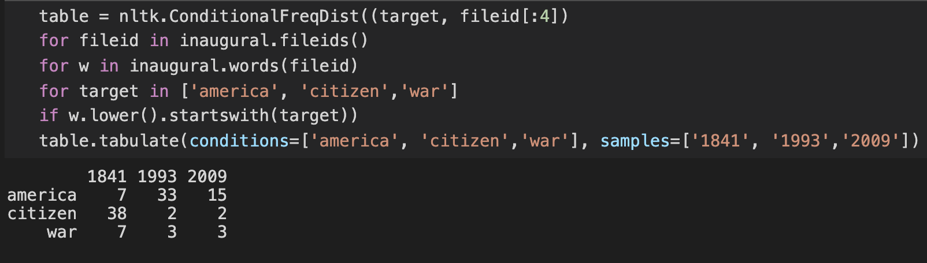
Conditional Frequency Distribution
The CFD is a function which can analyze and process the frequency of each item in a given list. This then gives a count of each occurrence of the item in that particular list.
As a function of NLTK, it can be used for collecting frequency distributions of given words and then given in a proper representation.
The conditional frequency distribution only increments the count when the given condition is met. It can record the number of times a sample event occurred when a simply experiment may be conducted repeatedly.
11

Slide 12
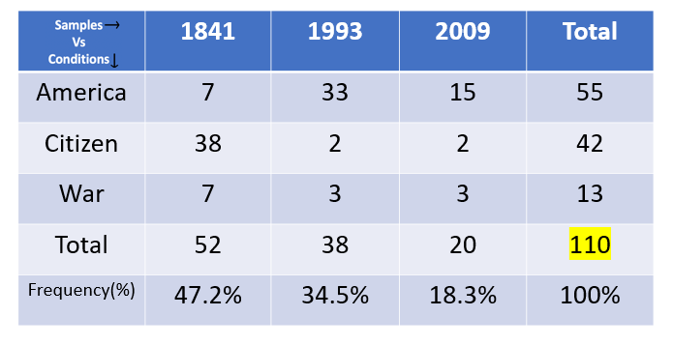
Conditional Frequency Distribution
CFD is primarily used for prediction. This is the problem which involves determining a likely outcome for a given set of events. The decision made is usually based on the context of the data. NLTK is able to process the probability from the data and predict a word’s outcome in the given context.
With CFD, we can find the most frequent outcome and then access the distribution for the given context with its indexing operator.
12

Slide 13
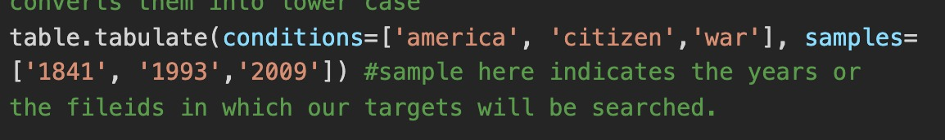
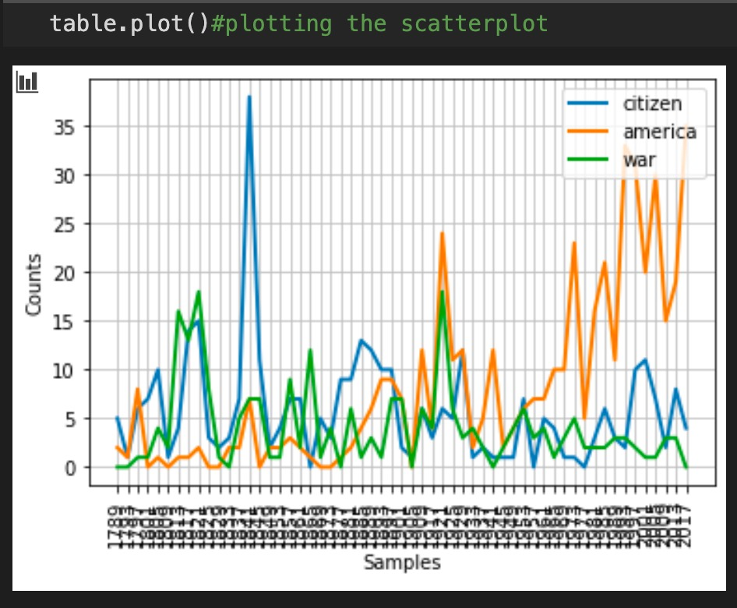
Tabulate Function in Python
13
The primary use case of the tabulate library in Python is representing data in tabular format without any hassle. By simply calling this function, the data can be formatted as per its own structure, and this can allow tabular data to be used for lightweight markup.
The data can then be transformed into a readable format including both text and numeric data, all represented in smart column-based alignment.

Slide 14
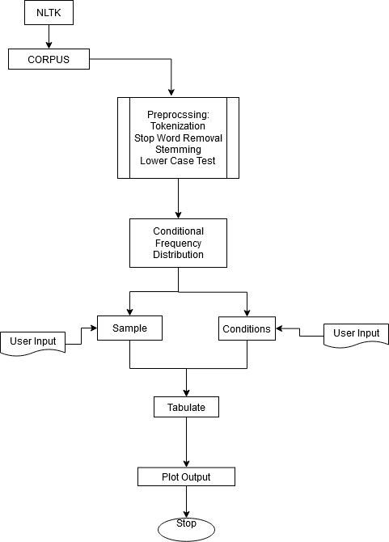
Algorithm Visualization
14

Slide 15
Project Explanation
15
Now, We will explain Text Count and Prediction using NLP by live demonstration of the working project we have worked on.

Slide 16
Real-World Applications
Our Project can have several real-world applications in the world of psychology and politics.
The frequency of certain words in a person’s speech can be used to predict their behavior since those are likely to be the thoughts they think most about.
If search engines release data in .txt format about searches per state, then this data can be used to predict who the likely winner of elections in that state would be. For e.g., if State A searches most for Candidate X, they are most likely to vote for Candidate X over Y.
16

Slide 17
Thank You
17

